Slide 1

Course: Information &
Communication Technology
May 2021
Google Analytics & Hootsuite
Session 15

Slide 2
AGENDA
1. GOOGLE ANALYTICS & HOOTSUITE
2. HOW TO USE GOOGLE ANALYTICS & HOOTSUITE
3. PRACTICE
4. QUIZ

Slide 3
1. GOOGLE ANALYTICS & HOOTSUITE

Slide 4
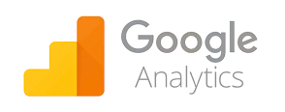
GOOGLE ANALYTICS
Google Analytics is a free web analytics tool offered by Google to help you analyze your website traffic. It involves the collection, measurement, and analysis of website data. Google Analytics tools can provide lots of useful information about the origin of website traffic, how website users navigate and interact throughout a website, what content and web pages they're most engaged with, and how they exit the site.
Why use Google Analytics?
                Helps you take data-led decisions
                Makes reporting easier
                Helps you deduce the ‘story’ behind the data
Benefits of Google Analytics
                It’s free
                It’s easy to implement and easy to install
                It has a user-friendly interface
                It offers customizable reports, dashboards, and data collection
                Both basic and advanced options are available
                It offers seamless integration with other Google products
                It offers post-click integration with non-Google traffic sources, including Facebook, Yahoo, and Bing
                It provides extensive, valuable insights into web behavior
https://digitalmarketinginstitute.com/blog/what-is-google-analytics
Notes:
google analytics adalah alat untuk menganalisis website yang dapat kalian gunakan secara gratis dari Google yang membantu kita untuk menganalisis traffic website. dengan google analytics, kita bisa mengkoleksi, mengukur dan menganalisis data dari website kita. google analytics dapat menyediakan berbagai informasi yang bermanfaat mengenai website kita seperti bagaimana navigasi user pada website, bagaimana user berinteraksi dengan website, konten dan halaman website mana yang paling sering dikunjungi, dan bagaimana mereka keluar dari website
benefit yang kalian dapatkan dari google analytics antara lain adalah:
Gratis
Mudah men-set up dan mengiplementasikannya
memiliki user friendly interface
menawarkan laporan, dashboard, dan pengumpulan data yang dapat di-customize
Tersedia opsi dasar dan advanced
dapat berintegrasi dengan produk Google lainnya
dapat berintegrasi juga dengan sumber traffic non-Google, seperti Facebook, Yahoo, dan Bing
Dapat memberikan insight dari web behavior yang luas dan bernilai
Mengapa kalian perlu menggunakan Google Analytics?
Membantu kalian mengambil keputusan berdasarkan data
Membuat report menjadi lebih mudah
Membantu kalian menyimpulkan 'cerita' di balik data

Slide 5

HOOTSUITE
Hootsuite is a social media management platform that covers almost every aspect of a social media manager's role. With just one platform users are able to do the simple stuff like curate cool content and schedule posts all the way up to managing team members and measuring ROI.
Why use Hootsuite?
Monitor Multiple Streams in One Place (Twitter, Facebook, Instagram, LinkedIn, etc)
Social media scheduling
Social media analytics
Hootlet Plug-In Allows You to Share Information Easily
Social Media Listening
Manage Customer Service on Social Media Efficiently
Team Collaboration
https://aspireinternetdesign.com/social-media-blogging/7-benefits-using-hootsuite-manage-companys-social-media/
Notes:
hootsuite adalah platform management social media. dengan 1 platform ini, user dapat secara simple mengkurasi konten, memposting, mengukur dan menganalisis suatu akun social media
kenapa kita perlu menggunakan hootsuite, antara lain adalah:
kita dapat memonitor berbagai platform social media dalam 1 tempat (Twitter, Facebook, Instagram, LinkedIn, etc)
kita dapat menjadwalkan waktu konten yang akan diposting
kita dapat menganalisis performa dari akun social media
plug in Hootlet dari Hootsuite dapat memudahkan kalian untuk berbagi informasi
Hootsuite dapat menjadi alat untuk mendengarkan percakapan apa di social media
kita dapat me-manage customer service secara efisien
kita juga dapat menggunakan Hootsuite secara berkelompok sehingga meningkatkan produktifitas kolaborasi sebuah team

Slide 6
2. HOW TO USE GOOGLE
ANALYTICS & HOOTSUITE

Slide 7
GET STARTED WITH GOOGLE ANALYTICS
To start collecting basic data from a website:
Create or sign in to your Analytics account:
  Go to google.com/analytics
  Do one of the following:
    To create an account, click Start for free.
    To sign in to your account, Click Sign in to Analytics.
Set up a property in your Analytics account. A property represents your website or app, and is the collection point in Analytics for the data from your site or app.
Set up a reporting view in your property. Views let you create filtered perspectives of your data; for example, all data except from your company’s internal IP addresses, or all data associated with a specific sales region.
Follow the instructions to add the tracking code to your website so you can collect data in your Analytics property.
https://support.google.com/analytics/answer/1008015?hl=en
Notes:
cara-cara untuk membuat akun google analytics dapat kalian simak pada slide berikut

Slide 8
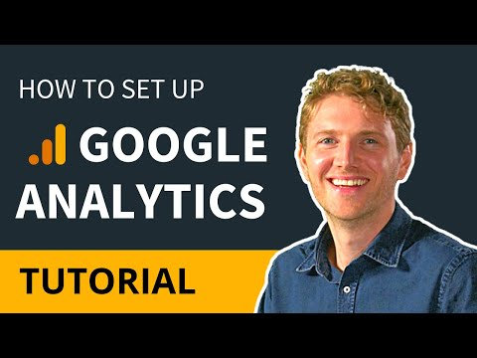
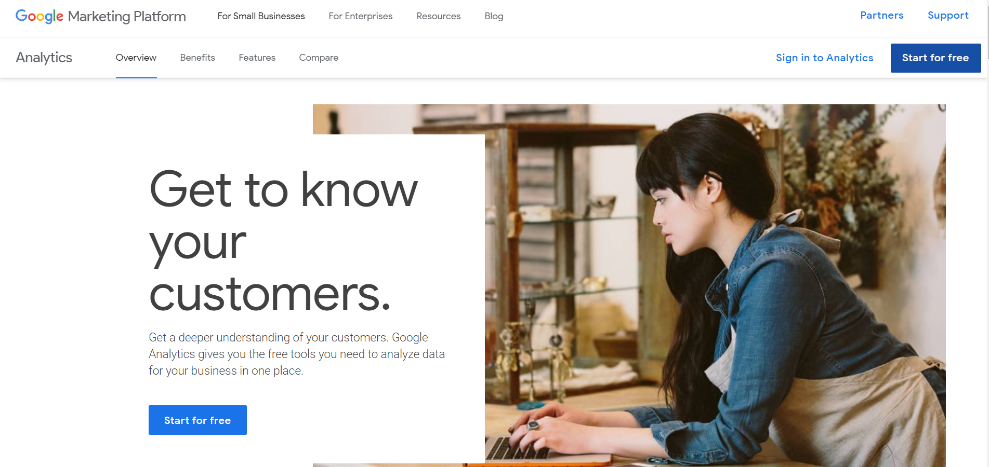
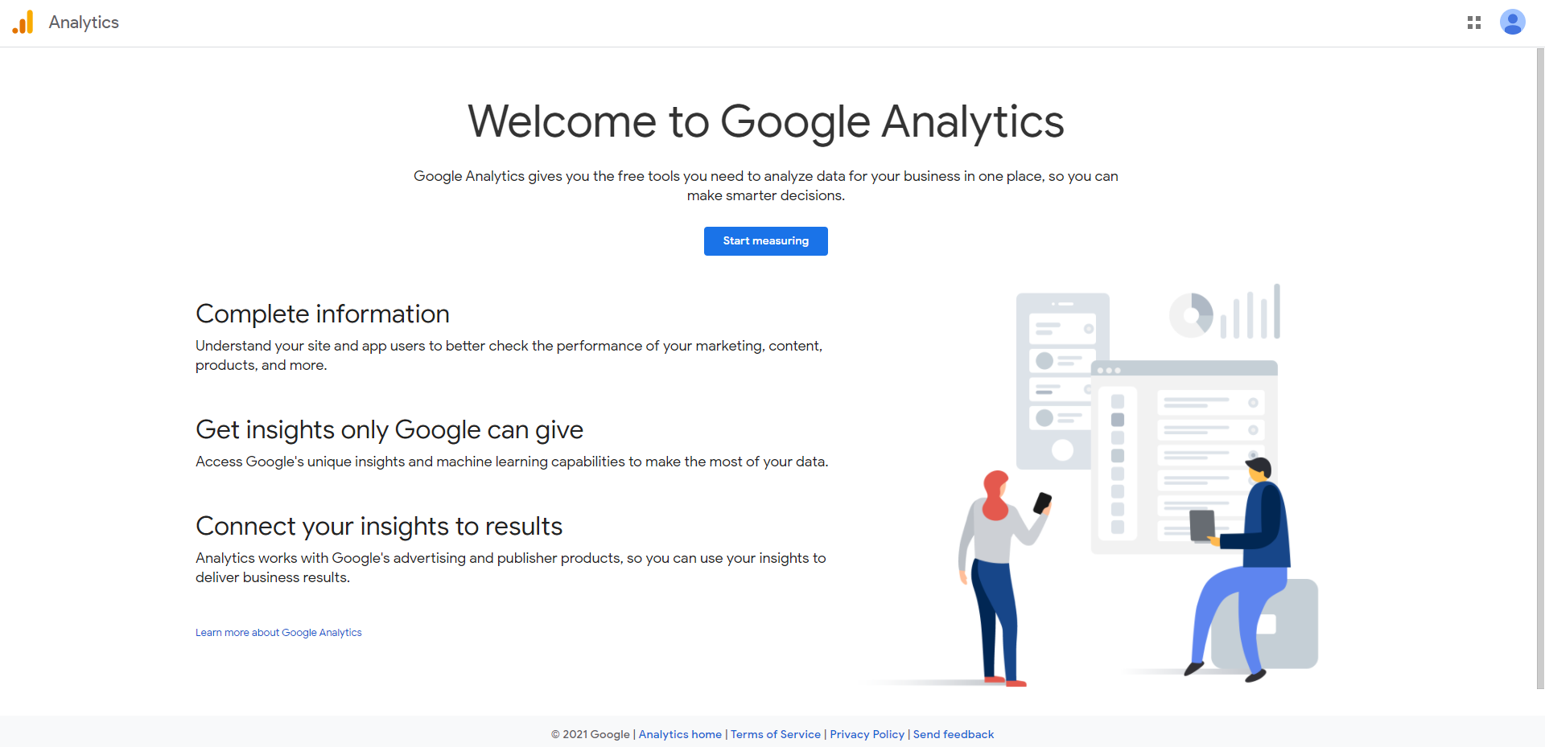
GET STARTED WITH GOOGLE ANALYTICS
https://marketingplatform.google.com/about/analytics/
Notes:
untuk memahami cara set up google analytics, kalian dapat menyimak video berikut

Slide 9
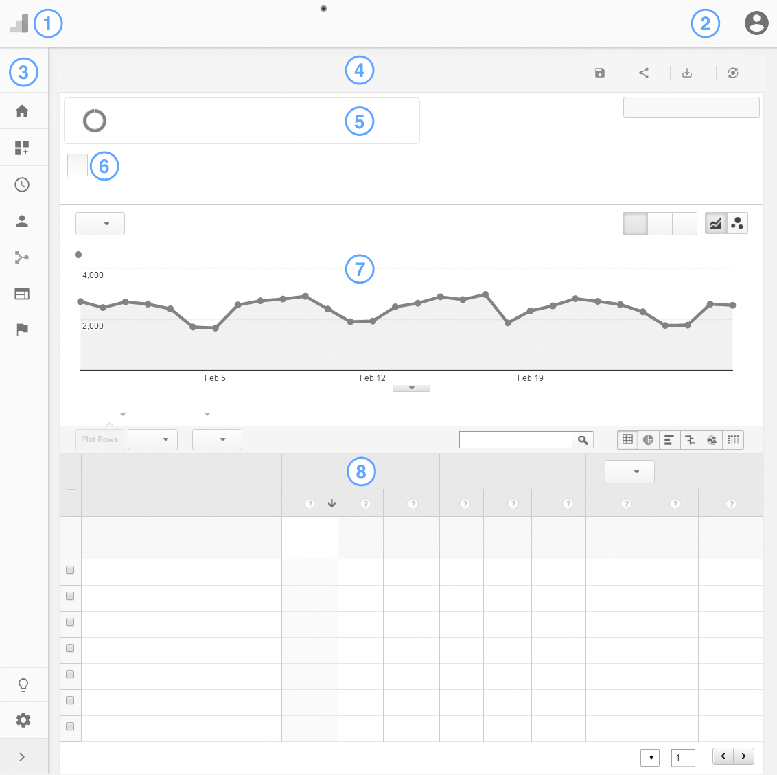
GOOGLE ANALYTICS REPORT
Organization and account links, search
Diagnostics and Google accounts
Report navigation
Action bar
Add segments, set the date range
Report tabs
Graph
Data table
https://support.google.com/analytics/answer/2604608?hl=en&ref_topic=3544906
Notes:
berikut adalah tampilan dari dashboard google analytics dan beberapa poin yang perlu kalian ketahui dalam menggunakannya

Slide 10
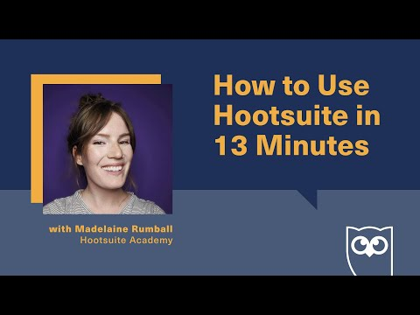
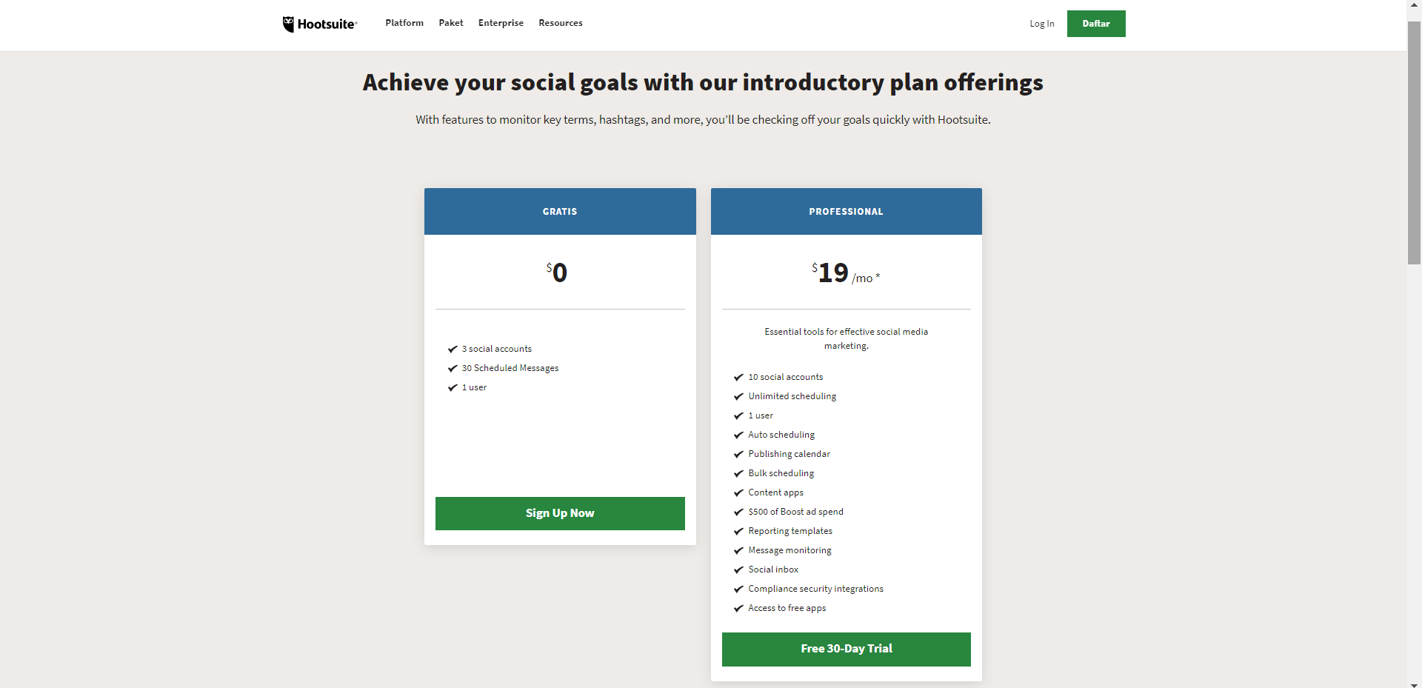
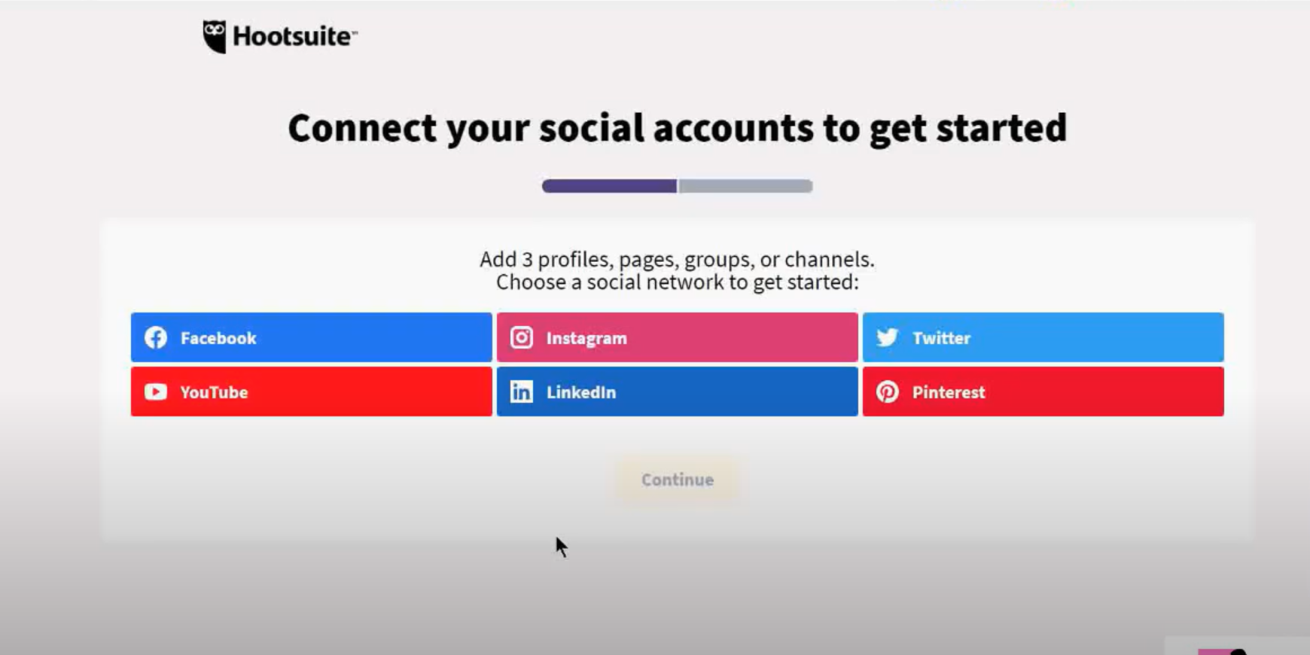
GET STARTED WITH HOOTSUITE
Notes:
setelah kalian mengetahui cara set up Google Analytics, berikut ini adalah cara-cara untuk set up hootsuite. yang dapat kalian simak pada video berikut

Slide 11
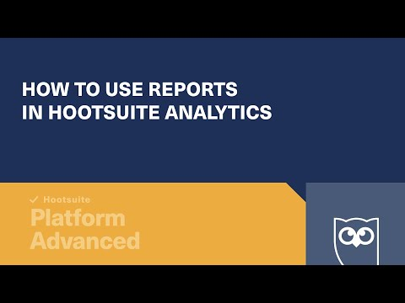
HOOTSUITE ANALYTICS REPORT
Notes:
untuk memahami cara melihat dan memahami report dari Hootsuite, kalian dapat menyimak video berikut.
Hootsuite menyajikan berbagai data yang kalian butuhkan untuk mengetahui performa dari akun social media kalian

Slide 12
3. PRACTICE

Slide 13
PRACTICE
Create your own website or blog
You can quickly create a blog on blogger.com, wordpress, Wix and implement Google Analytics. You will have to figure out a way to get traffic to your site/blog. You can start blogging about your journey of Google Analytics and drive traffic from search engines, your friends, your LinkedIn network, Facebook network etc. This blog/site will give you a chance to learn from your own site and data.
Create your own Google Analytics report by including these categories:
# of Total Visitors
# of New Visitors
# of Returning Visitors
Ave. Page Views per Visit
Ave. Time on Site
Bounce Rate
Traffic Sources

Slide 14
PRACTICE
Create your own social media business account
You can quickly create social media account for your business (Facebook fanpage, Twitter, Instagram) and connect using Hootsuite as social media management tools. You will have to figure out a way to increase awareness and engagement of your social media presence.
Create your own Hootsuite analytics report by including these categories:
Awareness:
Impressions are how many times a post shows up in someone’s timeline
Reach is the potential unique viewers a post could have (usually your follower count plus accounts that shared the post’s follower counts).
Engagement:
Likes, Comments, Retweets, etc.:
Post engagement rate
Account mentions

Slide 15
4. QUIZ

Slide 16
QUIZ
The function of Google Analytics is for:
  Analyze website traffic
  Design a website
  Promote a website
  Increase website traffic
  Get customers
Benefits of Google Analytics, except:
  It’s free
  It’s easy to implement and easy to install
  It offers seamless integration with other Google products
  It offers customizable reports, dashboards, and data collection
  It needs coding skill to use it
Why use Google Analytics?
  Difficult to make report
  Helps you take data-led decisions
  Hard to understand the story behind the data
  It’s quite expensive
  Can reach customers easily
4. Hootsuite is:
  Website traffic analytics
  Social media management platform
  Advertising tools
  Social media platform
  Website builder
5. These are the reasons to use Hootsuite, except:
Social media scheduling
Social media listening
Monitor multiple streams in one place
Social media analytics
Help us to get new followers

Slide 17
REFERENCES
Study.com. 2021. [online] Available at: <https://study.com/academy/lesson/what-is-web-traffic-definition-monitoring.html> [Accessed 18 March 2021].
Google. 2021. Introducing the new Google Analytics. [online] Available at: <https://blog.google/products/marketingplatform/analytics/new_google_analytics/> [Accessed 18 March 2021].
Inc., H., 2021. Hootsuite Free. [online] Hootsuite. Available at: <https://www.hootsuite.com/id/plans/free-account> [Accessed 18 March 2021].

Slide 18
Thank You

