Slide 1

Course: Information &
Communication Technology
May 2021
Website Traffic & Social Media
Session 14

Slide 2
AGENDA
1. WEBSITE TRAFFIC
2. SOCIAL MEDIA METRICS
3. PRACTICE
4. QUIZ

Slide 3
1. WEBSITE TRAFFIC

Slide 4
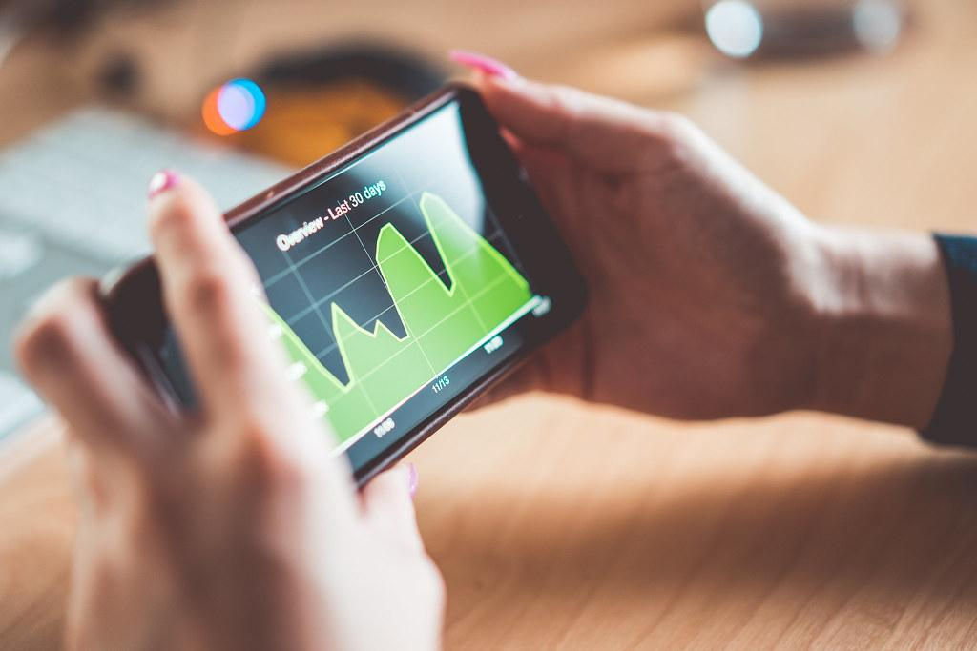
WEBSITE TRAFFIC
Definition
Website traffic refers to web users who visit a website. Web traffic is measured in visits, sometimes called "sessions," and is a common way to measure an online business effectiveness at attracting audiences.
“Web traffic is important — but not the only thing”
Not only "how many people visited?" but also:
How long did users stay?
What % of users made a purchase?
How much does it cost to bring in a visitor?
The Benefits:
You can monitor how effective your site is.
You can figure out how long visitors are sticking around.
You can see which pages are triggering visitors' interest.
You can monitor the impact of your marketing efforts.
You can determine where web traffic is coming from (such as social media sites).
You can increase the efficiency of your site overall.
https://www.bigcommerce.com/ecommerce-answers/what-is-website-traffic-and-how-to-interpret-it/
Notes:
Website traffic adalah pengguna web yang mengunjungi sebuah website. website traffic diukur melalui visits atau kunjungan, atau disebut juga dengan sessions. website traffic ini merupakan cara umum untuk mengukur keefektifitasan bisnis online dalam membuat audience tertarik atau tidak pada website bisnis online tersebut
Web traffic tidak hanya mengenai berapa banyak pengunjung website, tetapi juga berapa lama user melihat-lihat website, berapa persen user yang melakukan transaksi pembelian, dan seberapa besar biaya yang dibutuhkan untuk membawa user mengunjungi website
manfaat dari webtraffic ini antara lain adalah: kita dapat memonitor seberapa efektif website, kita dapat mencari tahu berapa lama pengunjung berada di website, kita dapat melihat halaman mana pada website yang membuat pengujung tertarik, kita dapat memonitor dampak dari rencana marketing yang dijalankan, kita dapat mengetahui darimana traffic ke website datang (misalnya dari social media), dan juga kita dapat meningkatkan keefektifitasan website secara keseluruhan

Slide 5
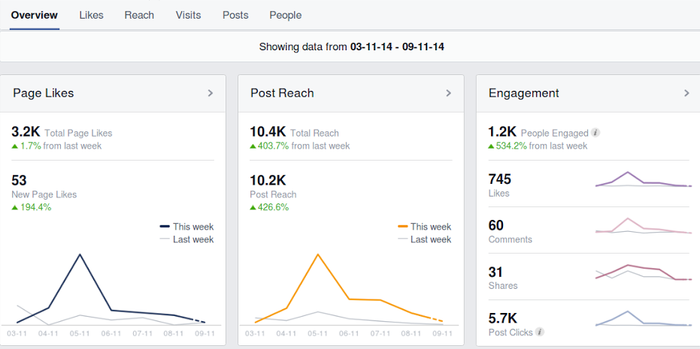
WEBSITE TRAFFIC MONITORING
What Should be Tracked?
# of Total Visitors
# of New Visitors
# of Returning Visitors
Ave. Page Views per Visit
Ave. Time on Site
Bounce Rate
Top Landing Pages
Top Exit Pages
Top Content
Social Media / Share Button Stats
Traffic Sources
Top Referring URLs
Lead Generating Goals
# of Leads
Ave # of Leads per Month
% of Visitors that Turned Into Leads
% of Leads that Turned Into Business (Conversion Rate)
Ongoing Return on Investment (Revenue – Cost)
Notes:
pada slide ini, kalian bisa melihat apa saja yang perlu kita monitor dari suatu website traffic

Slide 6
2. SOCIAL MEDIA METRICS

Slide 7
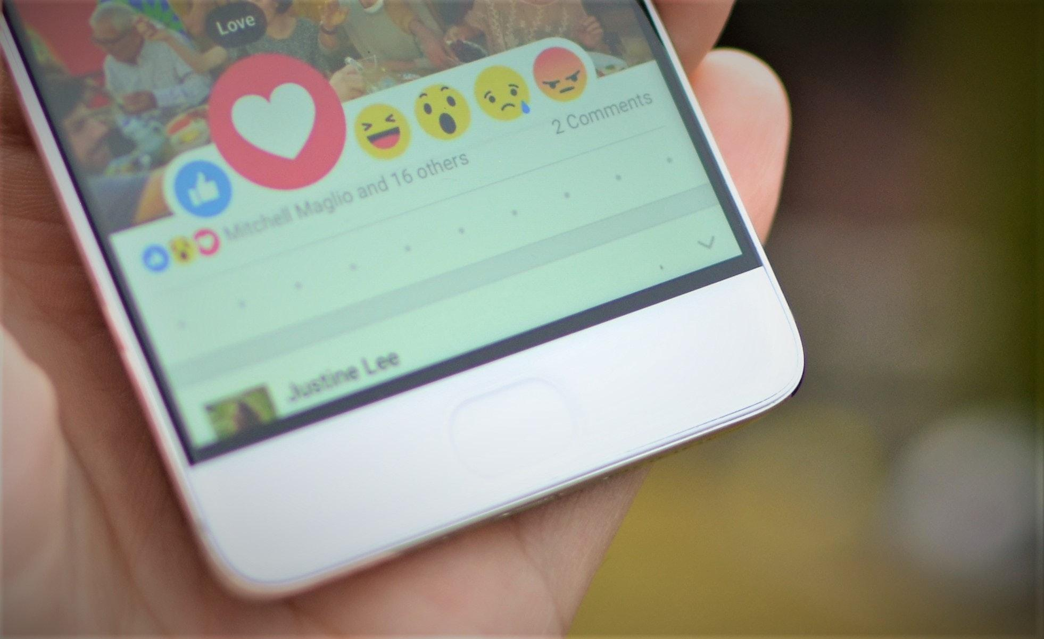
SOCIAL MEDIA METRICS
Engagement: Likes, comments, shares and clicks
Likes, Comments, Retweets, etc.: Individual engagement metrics like a Share or a Retweet add up. In a Twitter report, you’ll see a total number of engagements per post or profile.
Post engagement rate: The number of engagements divided by impressions or reach. A high rate means the people who see the post find it interesting.
Account mentions: Organic mentions, like @mentions that aren’t part of a reply, or tagging a brand in an Instagram story without prompting, indicate good brand awareness.
Awareness: Impressions & reach
Impressions are how many times a post shows up in someone’s timeline
Reach is the potential unique viewers a post could have (usually your follower count plus accounts that shared the post’s follower counts).
https://help.hootsuite.com/hc/en-us/articles/1260802321889-Metrics-in-Analytics#2
Notes:
pada social media metrics ada 2 hal penting yang diperlukan pengukuran. yang pertama adalah Engagement. yang termasuk ke dalam engagement antara lain adalah Likes, Comments, Shares and Clicks
yang kedua adalah awareness. yang termasuk ke dalam awareness antara lain adalah impressions dan reach. impressions adalah berapa kali post social media tampil pada timeline seseorang. contohnya, apabila 1 orang melihat postingan tersebut sebanyak 2 kali, maka impressionsnya terhitung 2. apabila 2 orang melihat postingan tersebut sebanyak 2 kali, maka impressionsnya terhitung 4.
sedangkan reach adalah berapa banyak unique viewers melihat postingan tersebut. contohnya, apabila ada 2 orang yang melihat suatu postingan sebanyak masing-masing 1 kali, maka reach nya adalah 2. apabila ada 2 orang yang melihat suatu postingan masing-masing sebanyak 2 kali, maka reach nya adalah tetap 2

Slide 8
3. PRACTICE

Slide 9
PRACTICE
Make analyses for these following:
social media analysis by choosing one instagram brand account period one week
website traffic analysis with website traffic analyst such as Alexa

Slide 10
4. QUIZ

Slide 11
QUIZ
Web users who visit a website refers to:
  Website monitoring
  Website traffic
  Website design
  Content
  Search engine
Web traffic is measured in:
  Visits
  Clicks
  Buy
  Play
  Like
These are the benefits of website traffic, except:
  You can monitor how effective your site is.
  You can figure out how long visitors are sticking around.
  You can increase the sales of your product
  You can see which pages are triggering visitors' interest.
  You can monitor the impact of your marketing efforts.
4. How many times a post shows up in someone’s timeline is the definition of:
Reach
Engagement
Landing page
Viewers
Impressions
5. The potential unique viewers a post could have is the definition of:
Mention
Reach
Impressions
Bounce rate
Leads

Slide 12
REFERENCES
Study.com. 2021. [online] Available at: <https://study.com/academy/lesson/what-is-web-traffic-definition-monitoring.html> [Accessed 18 March 2021].
Google. 2021. Introducing the new Google Analytics. [online] Available at: <https://blog.google/products/marketingplatform/analytics/new_google_analytics/> [Accessed 18 March 2021].
Inc., H., 2021. Hootsuite Free. [online] Hootsuite. Available at: <https://www.hootsuite.com/id/plans/free-account> [Accessed 18 March 2021].

Slide 13
Thank You

