Slide 1

Course: Information &
Communication Technology
May 2021
Branding for Digital Business
Session 10

Slide 2
AGENDA
1. DIGITAL BUSINESS
2. OPTIONS FOR COMPANIES TO REACH THEIR AUDIENCE ONLINE
3. THE SIX KEY TYPES OF DIGITAL MEDIA CHANNELS
4. BENEFITS FROM E-COMMERCE AND DIGITAL BUSINESS
5. PRACTICE

Slide 3
1. DIGITAL BUSINESS

Slide 4
1. DIGITAL BUSINESS
E-Commerce
Electronic commerce (e‐commerce) is all electronically mediated information exchanges between an organisation and its external stakeholders.
The scope of electronic commerce (e‐commerce) is narrower than digital business. It’s often thought simply to refer to buying and selling using the Internet; people immediately think of consumer retail purchases from companies such as Amazon. But e-commerce should be considered as all electronically mediated transactions between an organisation and any third party it deals with. By this definition, non- financial transactions such as customer support and requests for further information would also be considered to be part of e-commerce.
How businesses apply digital technology and media to improve the competitiveness of their organisation through optimising internal processes with online and traditional channels to market and supply.
Digital business is aimed at enhancing the competitiveness of an organisation by deploying innovative digital technologies throughout an organisation and beyond, through links to partners and customers and promotion through digital media

Slide 5
1. DIGITAL BUSINESS
Different Types of Sell-Slide E-Commerce
Sell-side e-commerce doesn’t only involve selling products online, but also involves using digital technologies to market services using a range of techniques
Transactional e-commerce sites. These enable purchase of products online. The main business contribution of the site is through sale of these products. The sites also support the business by providing information for consumers who prefer to purchase products offline. These include retail sites, travel sites and online banking services.
Services-oriented relationship-building websites. Provide information to stimulate purchase and build relationships, particularly where products are not suitable for sale online. Information is provided through the website and e-newsletters to inform purchase decisions. The main business contribution is through encouraging offline sales and generating enquiries or leads from potential customers, known as lead generation.
Brand-building sites. Provide an experience to support the brand. Products are not typically available for online purchase. Their main focus is to support the brand by developing an online experience of the brand. They are typical for low-value, high-volume fast-moving consumer goods (FMCG brands).
Publisher or media sites. Provide information, news or entertainment about a range of topics. This is information both on the site and through links to other sites. Media sites have a diversity of options for generating revenue, including advertising, commission-based sales and sale of customer data (lists).
Social network sites (SNS). Social networks could be considered to be in the previous category since they are often supported by advertising, but the influence of social networks such as Facebook, LinkedIn and Twitter on company and customer communications suggests they form a separate category.

Slide 6
1. DIGITAL BUSINESS
Digital Marketing
This has a similar meaning to ‘electronic marketing’ – both describe the management and execution of marketing using electronic media such as the web, email, IP TV and mobile media in conjunction with digital data about customers’ characteristics and behaviour.
Digital marketing, e-marketing or Internet marketing is yet another field that is closely related to e-commerce.
Different access platforms deliver content and enable interaction through a range of different online communication tools or media channels. Some are well-established techniques which will be familiar to you, like websites, search engines, email and text messaging. One of the most exciting things about working in digital media is the introduction of new tools and techniques which have to be assessed for their relevance to a particular marketing campaign.

Slide 7
2. REACH AUDIENCE ONLINE

Slide 8
2. REACH AUDIENCE ONLINE
To help develop a strategy to reach and influence potential customers online it has become commonplace today to refer to three main types of media channels marketers need to consider:
Paid media. These are bought media where there is investment to pay for visitors, reach or conversions through search, display advertising networks or affiliate marketing. Offline, traditional media like print and TV advertising and direct mail remain important, accounting for the majority of paid-media spend.
Earned media. Traditionally, earned media has been the name given to publicity generated through PR invested in targeting influencers to increase awareness about a brand. Now earned media also includes word-of-mouth that can be stimulated through viral and social media marketing and includes conversations in social networks, blogs and other communities. It’s useful to think of earned media as developed through different types of partners such as publishers, bloggers and other influencers, including customer advocates. Another way of thinking about earned media is as different forms of conversations between consumers and businesses occurring both online and offline.
Owned media. This is media owned by the brand. Online, this includes a company’s own websites, blogs, email list, mobile apps or their social presence on Facebook, LinkedIn or Twitter. Offline, owned media may include brochures or retail stores. It’s useful to think of a company’s own presence as media in the sense that they are an alternative investment to other media and they offer opportunities to promote products using similar ad or editorial formats to other media. It emphasises the need for all organisations to become multichannel publishers.

Slide 9
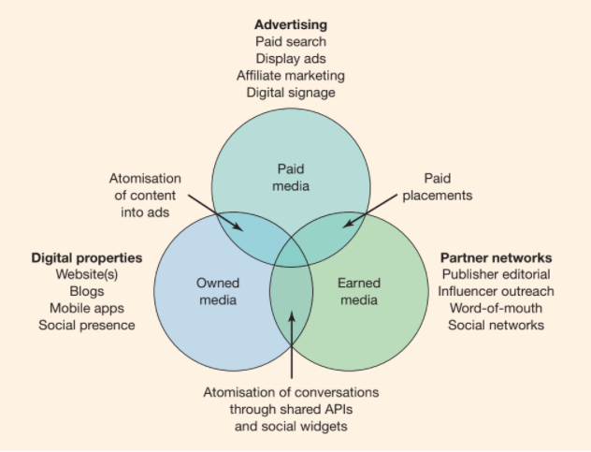
2. REACH AUDIENCE ONLINE
Figure 1. The three main options for online media investment

Slide 10
3. THE SIX KEY TYPES OF
DIGITAL MEDIA CHANNELS

Slide 11
3. THE SIX KEY TYPES OF DIGITAL MEDIA CHANNELS
There are many online communications techniques which marketers must review as part of their digital business communications strategy or as part of planning an online marketing campaign. To assist with planning, Chaffey and Smith (2012) recommend reviewing the six main types of digital media channels for reaching audiences:
Search engine marketing. Placing messages on a search engine to encourage clickthrough to a website when the user types a specific keyword phrase. Two key search marketing techniques are: paid placements or sponsored links using pay-​­per-​­click, and placements in the natural or organic listings using search engine optimisation (SEO).
Online PR. Maximising favourable mentions and interactions with a company’s brands, products or websites using third-party sites such as social networks or blogs that are likely to be visited by your target audience. It also includes responding to negative mentions and conducting public relations via a site through a press centre or blog. It is closely related to social media marketing.
Online partnerships. Creating and managing long-term arrangements to promote your online services on third-party websites or through email communications. Different forms of partnership include link building, affiliate marketing, aggregators such as price comparison sites like MoneySuperMarket (www.moneysupermarket.com), online sponsorship and co-branding.

Slide 12
3. THE SIX KEY TYPES OF DIGITAL MEDIA CHANNELS
Interactive advertising. Use of online ads such as banners and rich media ads to achieve brand awareness and encourage click through to a target site.
Opt-in email marketing. Renting email lists or placing ads in third-party e-newsletters or the use of an in-house list for customer activation and retention.
Social media marketing. Social media marketing is an important category of digital marketing which involves encouraging customer communications on a company’s own site, or a social presence such as Facebook or Twitter, or in specialist publisher sites, blogs and forums. It can be applied as a traditional broadcast medium, for example companies can use Facebook or Twitter to send messages to customers or partners who have opted in. However, to take advantage of the benefits of social media it is important to participate in customer conversations. These can be related to products, promotions or customer service and are aimed at learning more about customers and providing support, so improving the way a company is perceived.

Slide 13
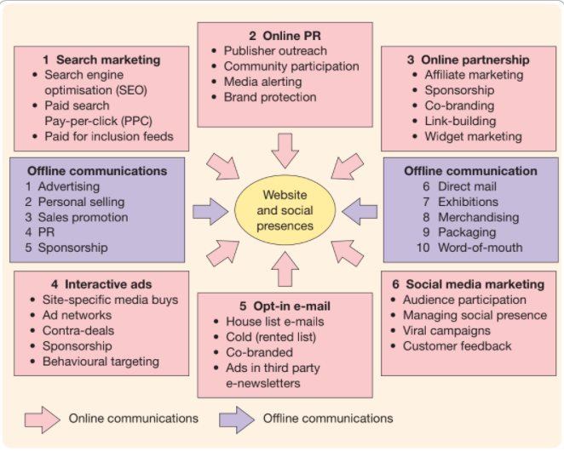
3. THE SIX KEY TYPES OF DIGITAL MEDIA CHANNELS
Figure 2. Digital and offline communications techniques

Slide 14
4. BENEFITS FROM E-COMMERCE AND DIGITAL BUSINESS

Slide 15
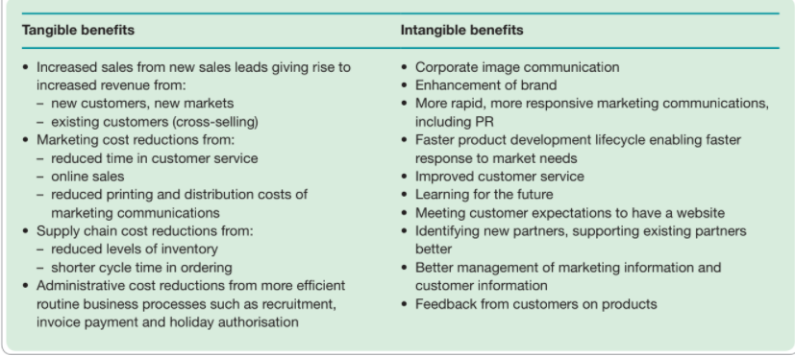
4. BENEFITS FROM E-COMMERCE AND DIGITAL BUSINESS
Figure 3. Tangible and intangible benefits from e‐commerce and digital business

Slide 16
5. PRACTICE

Slide 17
5. PRACTICE
Referring to your chosen company, please work individually to create a branding plan in only one A4 page for your company’s digital business with six key types of digital media channels.

Slide 18
REFERENCES
Chaffey, Dave. 2015. Digital Business & E-commerce Management. Pearson UK

Slide 19
Thank You

